Slide 1
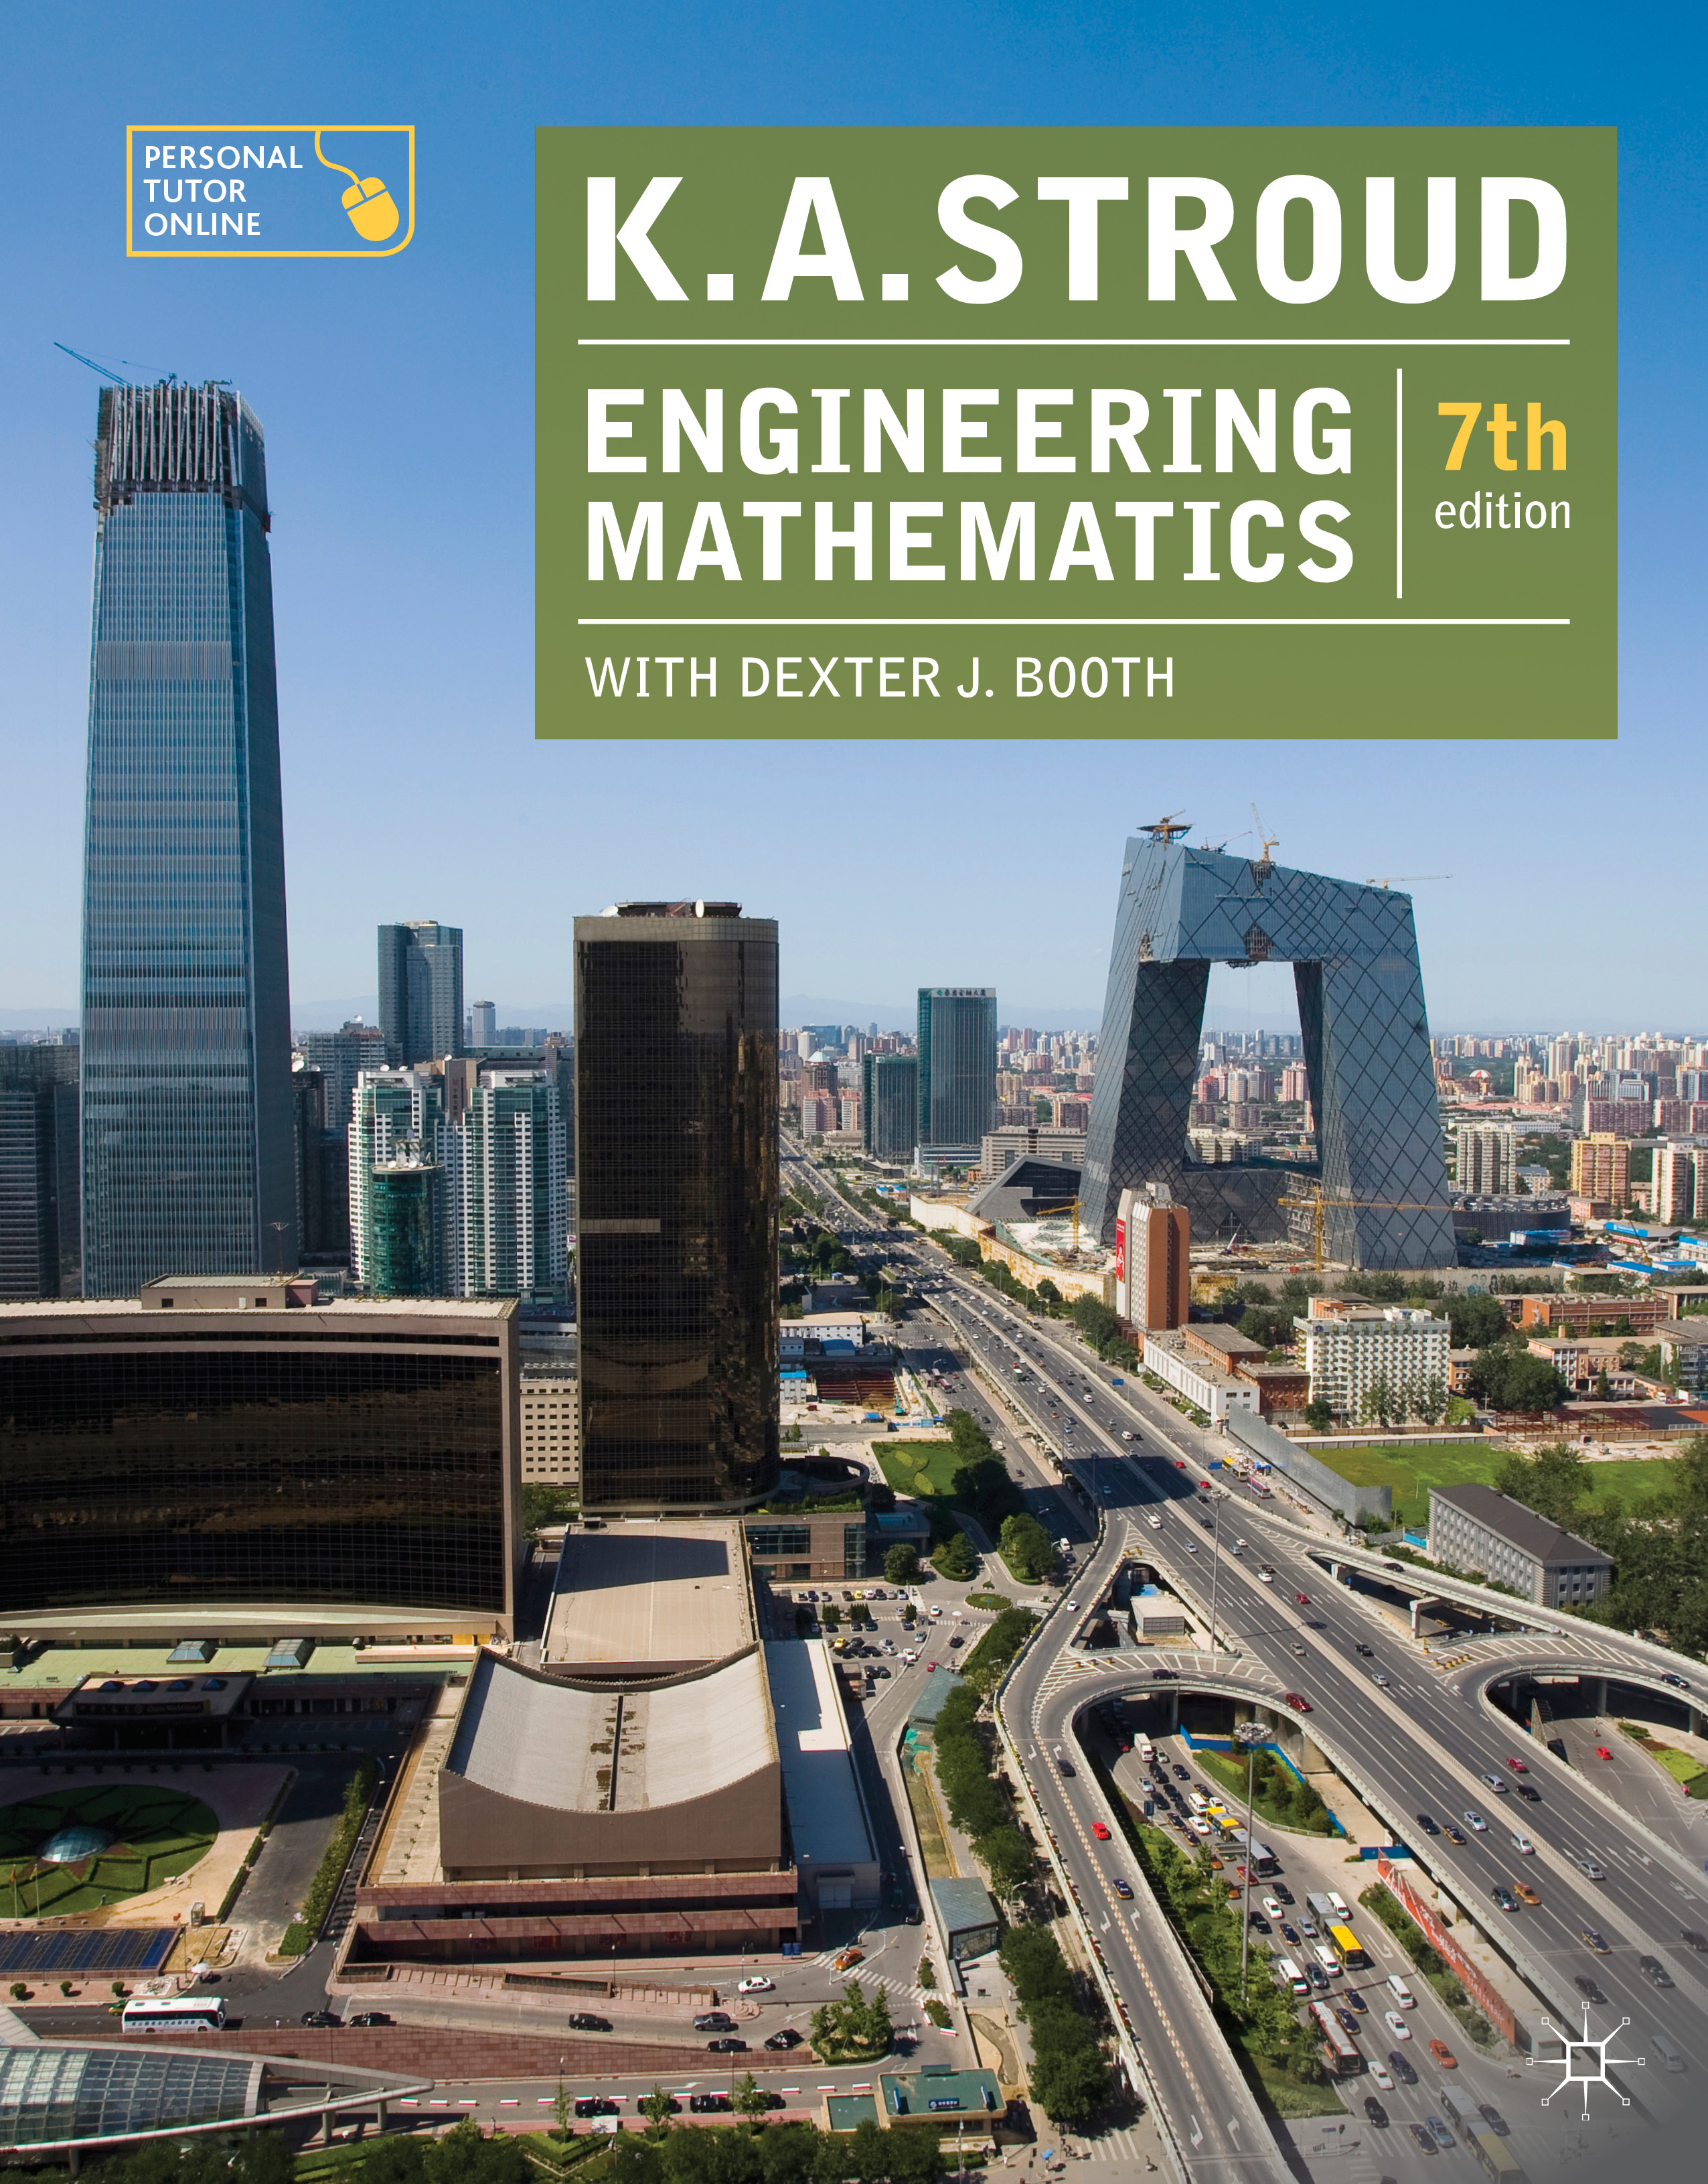
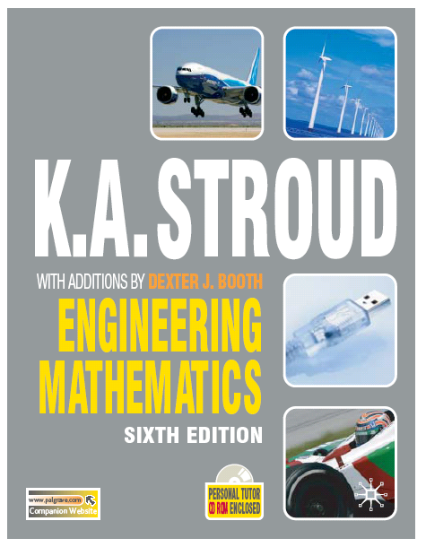
PROGRAMME 11
SERIES 1

Slide 2
Series
Series of powers of the natural numbers
Infinite series
Limiting values

Slide 3
Series
Series of powers of the natural numbers
Infinite series
Limiting values

Slide 4
Series
Sequences
Arithmetic series
Arithmetic mean
Geometric series
Geometric mean

Slide 5
Sequences
Sequences
A sequence is a set of quantities, u₁, u₂, u₃, . . . , stated in a given order and each term formed according to a fixed pattern, that is u_{r} = f (r).
A finite sequence contains only a finite number of terms.
An infinite sequence is unending.

Slide 6
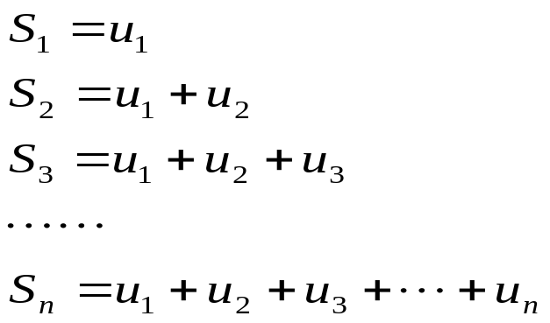
Series
Sequences
A series is formed from the partial sums of the terms of a sequence.
If u₁, u₂, u₃, . . . is a sequence then:
is a series

Slide 7

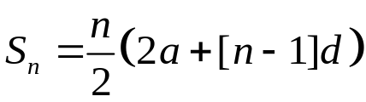
Series
Arithmetic series
The general term of an arithmetic sequence is defined as:
where a is the first term and d is the common difference.
The general term of an arithmetic series Sn is given as:

Slide 8

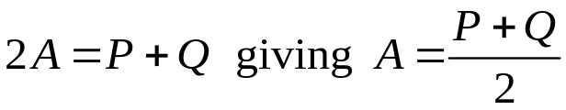
Series
Arithmetic mean
The arithmetic mean of two numbers P and Q is the number A such that:
form a term of an arithmetic series. That is:
so that:
The arithmetic mean of two numbers is their average

Slide 9

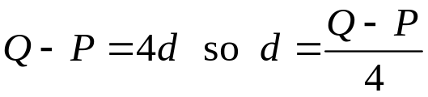
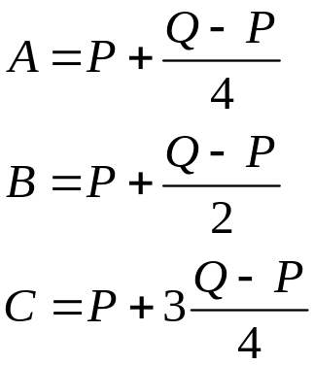
Series
Arithmetic mean
The three arithmetic means between two numbers P and Q are the numbers A, B and C such that:
form a term of an arithmetic series. That is,
and:

Slide 10

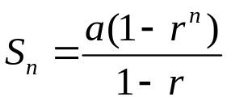
Series
Geometric series
The general term of a geometric sequence is defined as:
where a is the first term and d is the common ratio.
The general term of a geometric series Sn is given as:

Slide 11
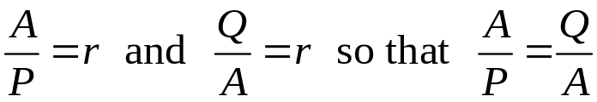

Series
Geometric mean
The geometric mean of two numbers P and Q is the number A such that:
form a term of a geometric series. That is:
so that:
The geometric mean of two numbers is the square root of their product

Slide 12
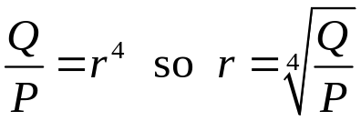
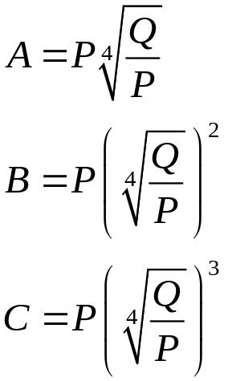
Series
Geometric mean
The three geometric means between two numbers P and Q are the numbers A, B and C such that:
form a term of a geometric series. That is, and:

Slide 13
Series
Series of powers of the natural numbers
Infinite series
Limiting values

Slide 14
Series
Series of powers of the natural numbers
Infinite series
Limiting values

Slide 15
Series of powers of the natural numbers
Sum of natural numbers
Sum of squares
Sum of cubes

Slide 16
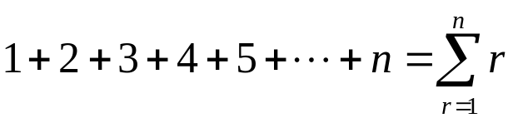
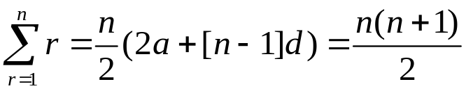
Series of powers of the natural numbers
Sum of natural numbers
The series:
is an arithmetic series with a = 1 and d = 1 so that:

Slide 17
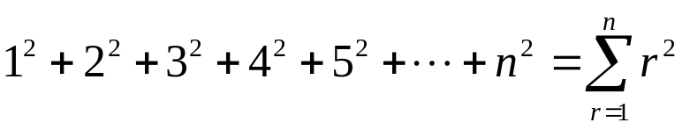

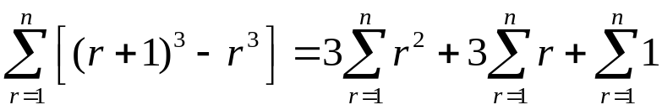
Series of powers of the natural numbers
Sum of squares
To find a similar expression for:
it is noted that:
And so:

Slide 18
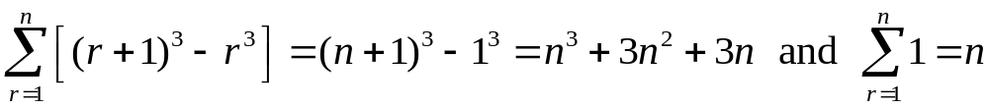
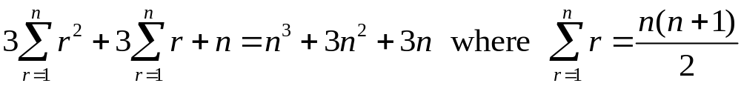
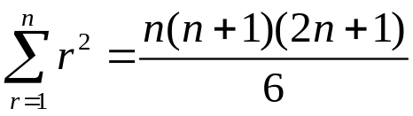
Series of powers of the natural numbers
Sum of cubes
Now:
Therefore:
And so:

Slide 19
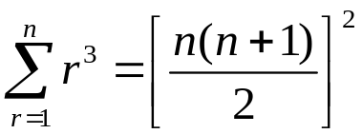
Series of powers of the natural numbers
Sum of cubes
Similarly, it is seen that:

Slide 20
Series
Series of powers of the natural numbers
Infinite series
Limiting values

Slide 21
Series
Series of powers of the natural numbers
Infinite series
Limiting values

Slide 22
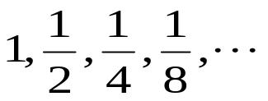
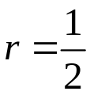
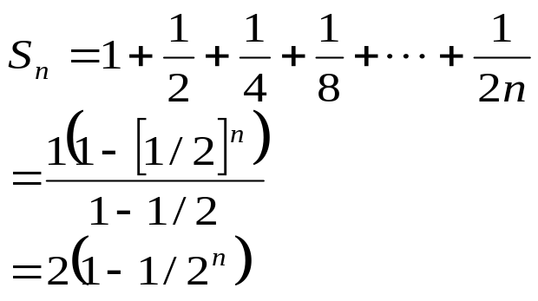
Infinite series
An infinite series is one whose terms continue indefinitely. For example, the sequence
is a geometric sequence where a = 1 and giving rise to the series whose general term is:

Slide 23
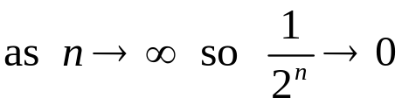
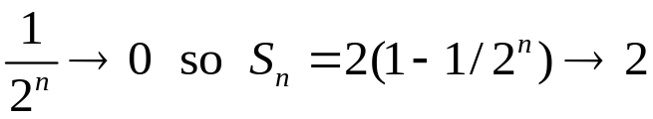

Infinite series
As n increase without bound so 1/2n decreases and approaches the value of zero. That is:
And as
We say that the limit of S_{n} as n approaches infinity (∞) is 2. That is:

Slide 24
Infinite series
Note that when it is stated that the limit of S_{n} as n approaches infinity is 2.
What is meant is that a value of S_{n} can be found as close to the number 2 as we wish by selecting a sufficiently large enough value of n.
S_{n} never actually attains the value of 2.

Slide 25

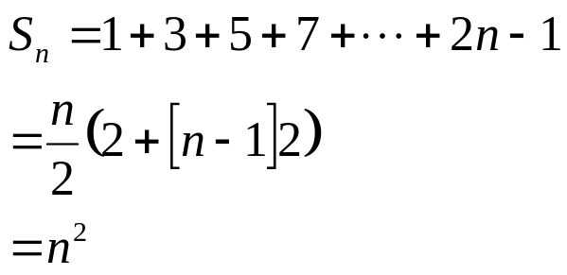
Infinite series
Sometimes the series has no limit. For example, the sequence
is an arithmetic sequence where a = 1 and d = 2 giving rise to the series whose general term is:

Slide 26


Infinite series
As n increases without bound so n² increases without bound also. That is:
The limit of S_{n} as n approaches infinity is itself infinity.
That is:
Because infinity is not defined the series does not have a limit.

Slide 27
Series
Series of powers of the natural numbers
Infinite series
Limiting values

Slide 28
Series
Series of powers of the natural numbers
Infinite series
Limiting values

Slide 29
Limiting values
Indeterminate forms
Convergent and divergent series
Tests for convergence
Absolute convergence

Slide 30
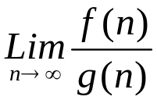


Limiting values
Indeterminate forms
An indeterminate form in a limit problem is one where a limit of a ratio is to be determined where both the numerator and the denominator in the ratio have either a zero limit or an infinite limit.
That is, a problem to determine:
where:
or where:

Slide 31
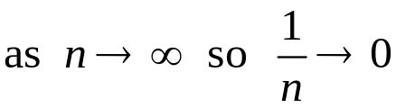
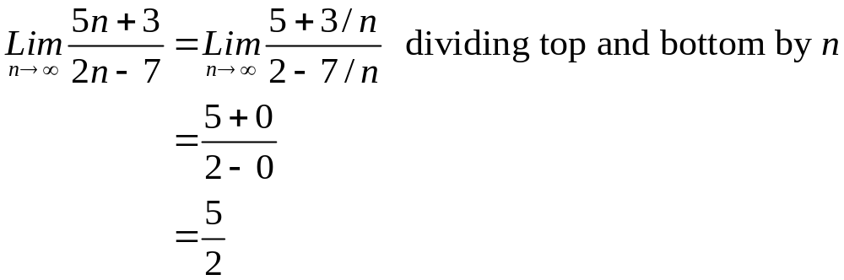
Limiting values
Indeterminate forms
The fact that:
can be usefully employed to find the limits of certain indeterminate forms. For example:

Slide 32
Limiting values
Convergent and divergent series
An infinite series whose terms tend to a finite limit is said to be a convergent series. If an infinite series does not converge then it is said to diverge.
If a formula for S_{n} cannot be found it may not be possible by simple inspection to decide whether or not a given series converges.
To help in this use is made of convergence tests.

Slide 33
Limiting values
Tests for convergence
Test 1: A series cannot converge unless its terms ultimately tend to zero
Test 2: The comparison test
Test 3: D’Alembert’s ratio test for positive terms

Slide 34


Limiting values
Tests for convergence
Test 1: A series cannot converge unless its terms ultimately tend to zero
If
Then S_{n} diverges if

Slide 35

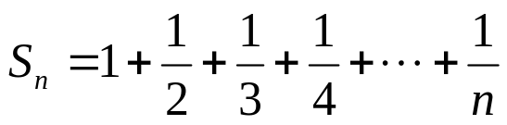
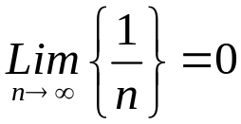
Limiting values
Tests for convergence
Test 1: A series cannot converge unless its terms ultimately tend to zero
Notice: This does not mean that if
then S_{n} converges. For example, the series:
diverges despite the fact that

Slide 36
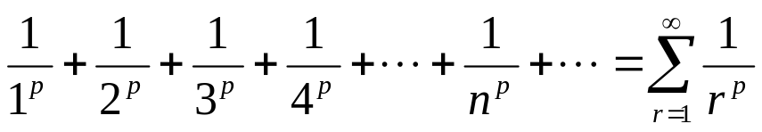
Limiting values
Tests for convergence
Test 2: The comparison test
A series of positive terms is convergent if its terms are less than the corresponding terms of a positive series which is known to be convergent.
A useful series for comparison purposes is the series:
which converges if p > 1

Slide 37
Limiting values
Tests for convergence
Test 2: The comparison test
Similarly, a series of positive terms is divergent if its terms are greater than the corresponding terms of a positive series which is known to be divergent.
A useful series for comparison purposes is the series :
which diverges if p ≤ 1

Slide 38
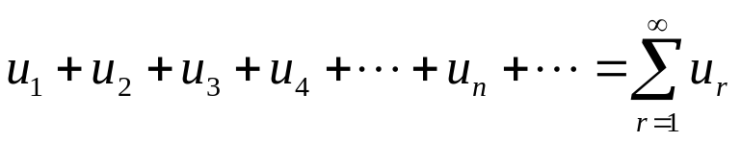
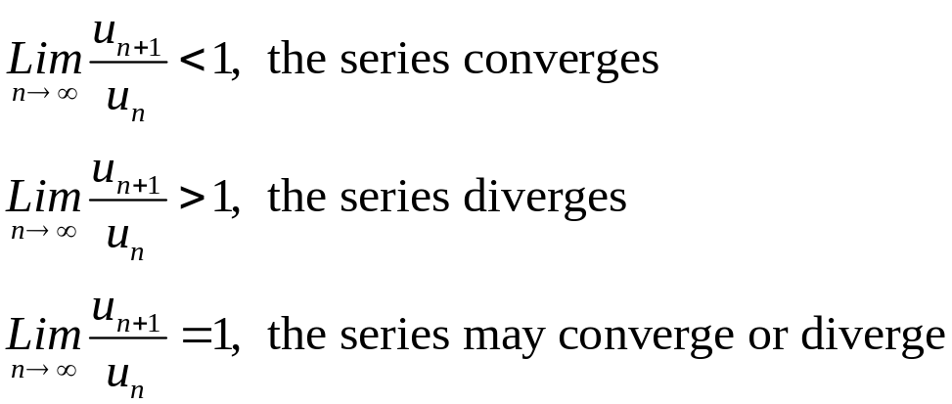
Limiting values
Tests for convergence
Test 3: D’Alembert’s ratio test for positive terms
If
is a series of positive terms then if:

Slide 39
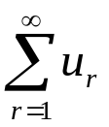
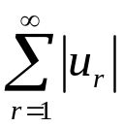
Limiting values
Absolute convergence
If a series
converges then the series of absolute values of the terms
may or may not converge.

Slide 40
Limiting values
Absolute convergence
If a series
converges and the series of absolute values of the terms
also converges the series
is said to be absolutely convergent.

Slide 41
Limiting values
Absolute convergence
If a series
converges but the series of absolute values of the terms
diverges the series
is said to be conditionally convergent.

Slide 42
Learning outcomes
Manipulate arithmetic and geometric series
Manipulate series of powers of the natural numbers
Determine the limiting values of arithmetic and geometric series
Determine the limiting values of simple indeterminate forms
Apply various convergence tests to infinite series
Distinguish between absolute and conditional convergence

